Slide 1
Database Management System
Relational Model
Antu Chowdhury
Lecturer
Dept. of CSE, EWU

Slide 2
Relational Model Concepts
2
The relational model stores a database as a collection of tables.
Each table is called a relation.
Each row in a table represents one real-world object or event.
Each column represents a type of information about that object.
Student Table
Student_ID | Name | Department
101 | Rahim | CSE
102 | Karim | EEE
The table name Student tells us what the data is about.
Each row represents one student (a real-world entity).
Each column name explains what kind of value is stored (ID, name, department).

Slide 3
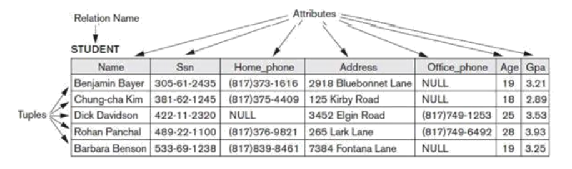
Relational Model Concepts
2
In the formal relational model terminology,
a row is called a tuple,
a column header is called an attribute,
the table is called a relation.
The data type describing the types of values that can appear in each column is represented by a domain of possible values.

Slide 4
Domains, Attributes, Tuples, and Relations
2
The set of allowed values for each attribute is called the domain of the attribute.
Some examples of domains follow:
  BD_phone_numbers: The set of 11-digit phone numbers valid in BD.
  Employee_ages: Possible ages of employees in a company; each must be an integer value between 15 and 80.
Attribute values are (normally) required to be atomic; that is, single and indivisible. E.g. the value of an attribute can be an account number but cannot be a set of account numbers. Full name attribute can be split into first name , last name to ensure atomicity.
The special value null is a member of every domain. Indicated that the value is “unknown”

Slide 5
Relations are Unordered
2
Order of tuples is irrelevant (tuples may be stored in an arbitrary order)
Example: instructor relation with unordered tuples

Slide 6
Relation Schema
2
A relation schema R,
  R = (A₁, A₂, …, A_{n} ) is a relation schema where A₁, A₂, …, A_{n} are attributes
  Example:
  instructor = (ID, name, dept_name, salary)
  Customer_schema = (customer_name, customer_street, customer_city)
A relation instance is the actual data stored in the table at a particular time. Denoted as: r(R)
This means a relation r that follows the schema R.
Example:
  customer (Customer_schema)
A tuple is a single row in a relation instance.

Slide 7
Database
2
A database consists of multiple relations
Information about an enterprise is broken up into parts, with each relation storing one part of the information
account: stores information about accounts
depositor : stores information about which customer owns which account
customer : stores information about customers
Storing all information as a single relation such as
bank(account_number, balance, customer_name, ..) results in repetition of information e.g.,if one customer owns several accounts (What gets repeated?)
the need for null values e.g., to represent a customer without an account
Normalization theory explains how to design tables properly to avoid these problems.

Slide 8
Key Constraints and Constraints on NULL Values
2
A key is a set of one or more attributes that can uniquely identify each row in a table. A key not only identifies the rows of a table but also relates two or more tables.
Different Types of Keys:
1) Super Key
2) Candidate Key
3) Primary Key
4) Foreign Key
5) Secondary Key/Alternate Key
6) Unique Key
7) Composite Key

Slide 9
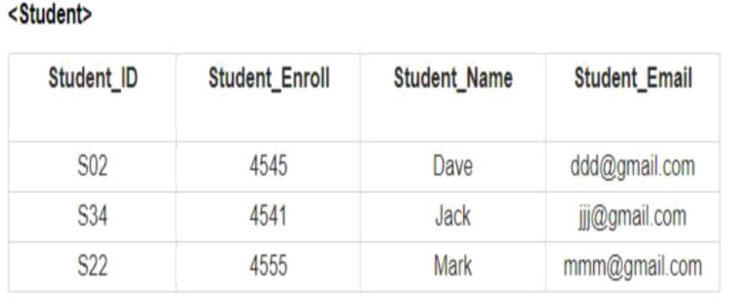
Key Constraints – Super Key
2
K is a superkey of R if values for K are sufficient to identify a unique tuple of each possible relation r(R) .

Slide 10
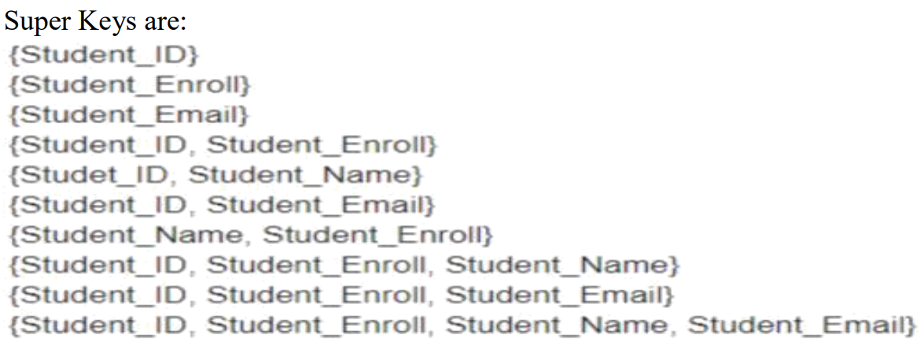
Key Constraints – Super Key
2
K is a superkey of R if values for K are sufficient to identify a unique tuple of each possible relation r(R) .

Slide 11
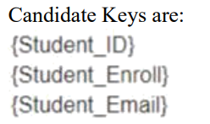
Key Constraints – Candidate Key
2
Superkey K is a candidate key if K is minimal

Slide 12
Key Constraints – Primary Key
2
One of the candidate keys is selected to be the primary key.
  Which one?
  Should choose an attribute whose value never, or very rarely, changes.
  E.g. email address is unique, but may change
The main difference between the primary key and the candidate key in that is primary key does not contain NULL values.
✓ Primary Key must be UNIQUE and NOT NULL.

Slide 13
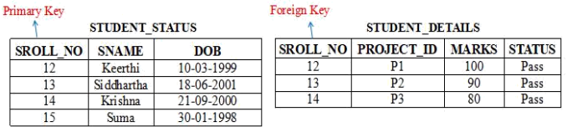
Key Constraints – Foreign Key
2
A foreign key is a set of attributes in a table that refers to the primary key of another table.
Only values occurring in the primary key attribute of the referenced relation may occur in the foreign key attribute of the referencing relation.

Slide 14
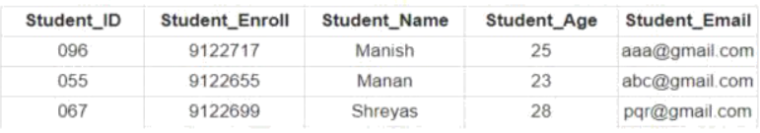
Key Constraints – Secondary Key
2
A primary key is the field in a database that is the primary key used to uniquely identify a record in a database. A secondary key is an additional key, or alternate key, which can be use in addition to the primary key to locate specific data.
Secondary Key is the key that has not been selected to be the primary key. However, it is considered a candidate key for the primary key.
Note: Secondary Key is not a Foreign Key.
Student_ID, Student_Enroll and Student_Email are the candidate keys. Select any one of the candidate key as the primary key. Rest of the two keys would be Secondary Key.

Slide 15
Key Constraints – Unique Key
2
A Unique Key is used to prevent duplicate values in a column.
A primary key cannot accept NULL values; this makes Primary Key different from unique Key, since Unique Key allows one value as NULL value.
A table can only have a single Primary Key, whereas a Unique Key can be more than one if you need it in the table.
Unique Key ensures that data is not duplicated in two rows in the database. A row in the database can have null in case of Unique Key.
You cannot modify a Primary Key, but a Unique Key can be modified.

Slide 16
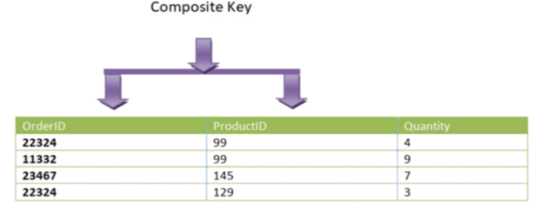
Key Constraints – Composite Key
2
A primary key having two or more attributes is called composite key. It is a combination of two or more columns
Example 1: Here our composite key is OrderID and ProductID −
{OrderID, ProductID}

Slide 17
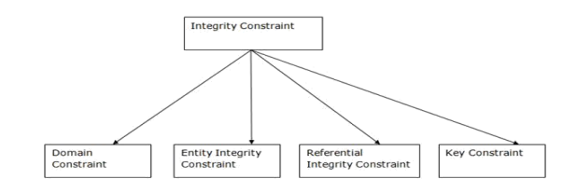
Integrity, Referential Integrity, and Foreign Keys
2

Slide 18
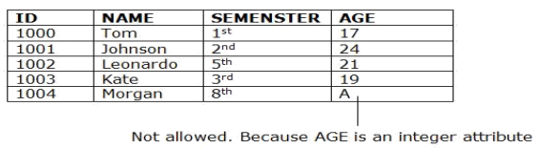
Integrity, Domain Constraints
2
Domain Constraints:
✓ Domain constraints can be defined as the definition of a valid set of values for an
attribute.
✓ The data type of domain includes string, character, integer, time, date, currency, etc. The value of the attribute must be available in the corresponding domain.

Slide 19
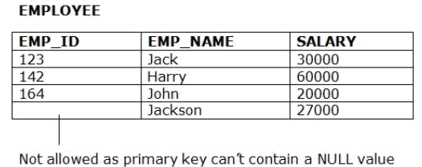
Integrity, Entity Integrity Constraints
2
Entity integrity constraints
✓ The entity integrity constraint states that primary key value can't be null.
✓ This is because the primary key value is used to identify individual rows in relation and if
the primary key has a null value, then we can't identify those rows.
✓ A table can contain a null value other than the primary key field

Slide 20
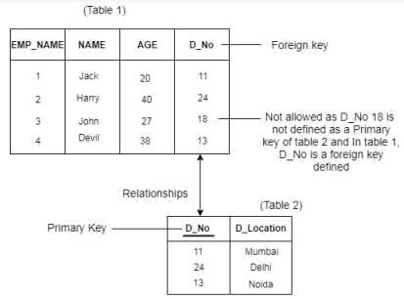
Integrity, Referential Integrity Constraints
2
Referential Integrity Constraints
✓ A referential integrity constraint is specified between two tables.
✓ In the Referential integrity constraints, if a foreign key in Table 1 refers to the
Primary Key of Table 2, then every value of the Foreign Key in Table 1 must be null or be available in Table 2

